Slide 1
TQM IN HEALTHCARE SERVICES:
rocusius ou
APOLLO HOSPITAL
Brief Overview

Slide 2


INTRODUCTION TO TQM IN HEALTHCARE
Focusing on Apollo Hospital
Adoption of TQM Practices
Apollo Hospitals has embraced Total Quality Management (TQM) practices to enhance the quality of healthcare services.
fiocus on Continuous Improvement The institution emphasizes continuous improvement in all aspects of healthcare delivery.
Patient Safety
A significant focus of TQM implementation is ensuring patient safety throughout the healthcare process.
Regulatory Compliance
Apollo Hospitals aims to meet all regulatory standards as part of its TQM strategy.
Streamlined Processes
Through TQM, processes have been streamlined to enhance efficiency and effectiveness in service delivery.
Reduction of Errors
The implementation of TQM has led to a noticeable reduction in errors within healthcare services.
Improved Patient Satisfaction Apollo Hospitals aims to improve
patient satisfaction as a direct outcome of TQM practices.
Aim for Best Possible Care
The overarching goal of TQM at Apollo Hospitals is to provide the best possible care to patients.
^œn'ea 1°nç preseutotions

Slide 3
STRENGTHS OF APOLLO HOSPITALS
Quality Standards
Customer Satisfaction
Apollo Hospitals adhere to global healthcare standards like jCl joint Commission International) and NABH (National Accreditation Board for Hospitals).
TQM initiatives have improved patient feedback scores.
Process Improvement
Employee Involvement
Continuous monitoring and refinement of medical and administrative processes.
Training programs ensure that all staff understand quality improvement principles.
^œn'ea 1°nç preseutotions

Slide 4
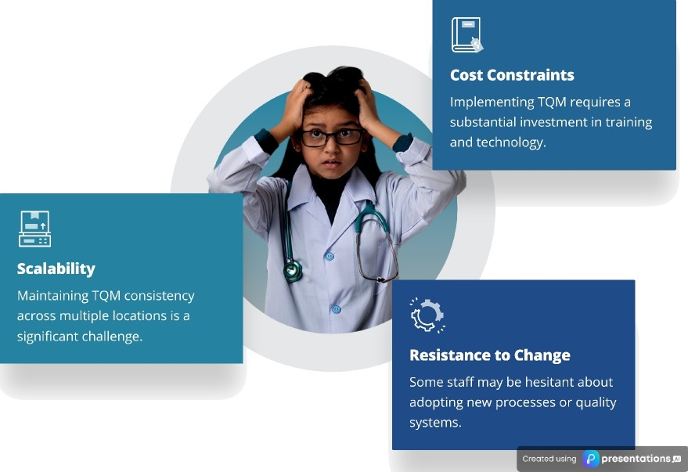

CHALLENGES FACED BY APOLLO HOSPITALS
Identifying Key Issues in Total Quality Management

Slide 5

KEY LEARNINGS FROM TQM IMPLEMENTATION
Continuous Improvement
The importance of continuous improvement for achieving high standards in healthcare.
Technology's Role
The role of technology in tracking performance and improving service quality.
Employee Involvement
Employee involvement is crucial to the successful implementation of TQM.
^œn'ea 1°nç preseutotions

Slide 6


RECOMMENDATIONS FOR ENHANCING TQM

